Slide 1
RIF V4.0
Database Design

Slide 2
V4.0 RIF Database Design
The aim of this talk is to introduce the new version 4 RIF database. The talk focuses on:
Different table types.
Database design documentation.
Differences between the V3.1 RIF and V4.0.
Handling porting issues: Postgres, Microsoft SQL Server and Oracle support.

Slide 3
V4.0 RIF Database Design
You will need to join Github and add yourself to the rapidInquiryFacility team (this is moderated by Kev) and clone it. You will then have full access to the source code.
On Windows use the GitHub tool.
On Linux use Git command directly.

Slide 4
1. V4.0 RIF Table types
Meta data tables. These are the RIF configuration tables, e.g. RIF40_TABLES.
Working tables, e.g. RIF40_STUDIES. These always contain a study_id column!
Data tables, e.g. health, population, covariate data, ICD9/10 and standard populations.
Study tables. These contain the study extracts and results data.

Slide 5
V4.0 RIF Meta data tables
Used to setup the RIF. Will be managed by the RIF data loading tool. Currently setup manually with the SAHSUland example database.
Generally follows the same convention as V3.1 RIF with RIF40_ on the front.

Slide 6
2. V4.0 RIF Design Documentation
Any early draft of the database design documentation was created using http://dbmstools.sourceforge.net/.
See: https://github.com/smallAreaHealthStatisticsUnit/rapidInquiryFacility/wiki/Database-design
This is the standard SAHSULAND database as at the SQL server port split.
You will need to have rapidInquiryFacility as a local repository in Github for Windows or view index-sahsuland-postgres8.html in Github: rapidInquiryFacility\rifDatabase\ERD\docs

Slide 7
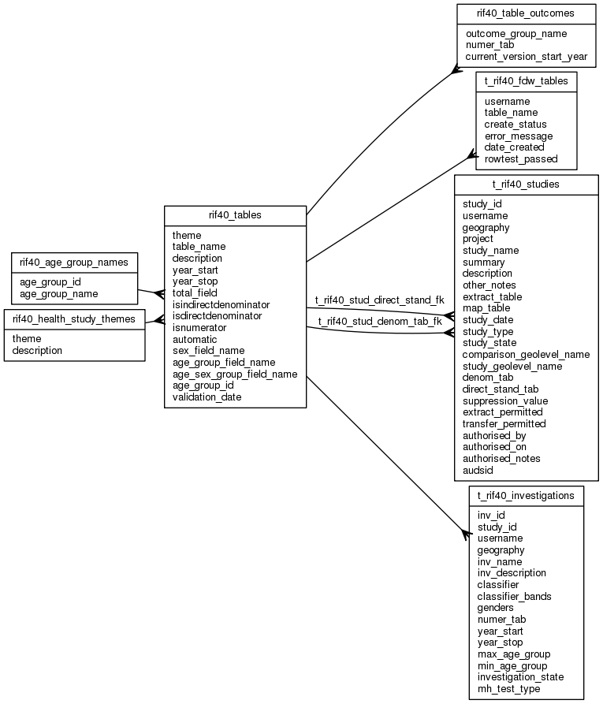
V4.0 RIF Design Documentation
Example: 1
RIF40_TABLES
Defines RIF numerator and denominator (data) tables

Slide 8
V4.0 RIF Design Documentation
Example: 1
RIF40_TABLES
Defines RIF numerator and denominator (data) tables
Working tables

Slide 9
V4.0 RIF Design Documentation
Meta data
Example: 1
RIF40_TABLES
Defines RIF numerator and denominator (data) tables

Slide 10
V4.0 RIF Design Documentation
Outcomes
Example: 1
RIF40_TABLES
Defines RIF numerator and denominator (data) tables
Notes:
Health outcomes – ICD 9/10 single/multi column support HES A+E and oper (OPCS4) codes, Oncology, birth weight support

Slide 11
V4.0 RIF Design Documentation
Oracle support
Example: 1
RIF40_TABLES
Defines RIF numerator and denominator (data) tables
Information governance

Slide 12
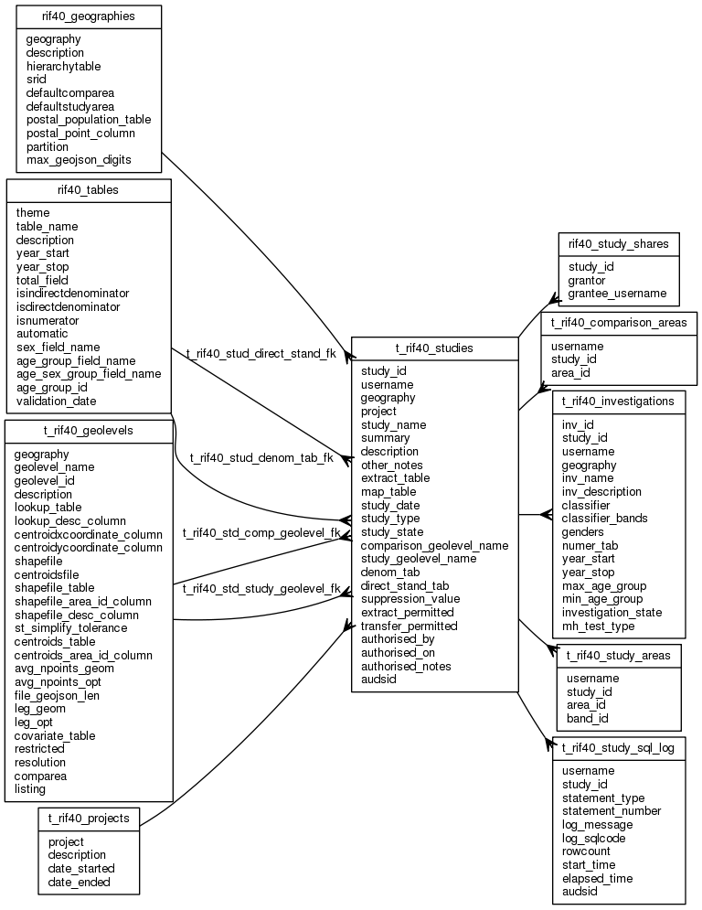
V4.0 RIF Design Documentation
T_RIF40_STUDIES
Defines RIF studies
Notes:
RIF40_STUDIES is a view with the same fields that only displays the study rows you can access.
The RIF40_STUDIES view must be used for SELECT, INSERT, UPDATE and DELETE
T_RIF40_STUDIES is not accessible by normal users.

Slide 13
V4.0 RIF Design Documentation
T_RIF40_STUDIES
Defines RIF studies
Notes:
RIF40_STUDIES is a view with the same fields that only displays the study rows you can access.
The RIF40_STUDIES view must be used for SELECT, INSERT, UPDATE and DELETE
T_RIF40_STUDIES is not accessible by normal users.
Working tables

Slide 14
V4.0 RIF Design Documentation
T_RIF40_STUDIES
Defines RIF studies
Notes:
RIF40_STUDIES is a view with the same fields that only displays the study rows you can access.
The RIF40_STUDIES view must be used for SELECT, INSERT, UPDATE and DELETE
T_RIF40_STUDIES is not accessible by normal users.
Meta data

Slide 15
V4.0 RIF Design Documentation
T_RIF40_STUDIES
Defines RIF studies
Notes:
RIF40_STUDIES is a view with the same fields that only displays the study rows you can access.
The RIF40_STUDIES view must be used for SELECT, INSERT, UPDATE and DELETE
T_RIF40_STUDIES is not accessible by normal users.
Information Governance: Project Management

Slide 16
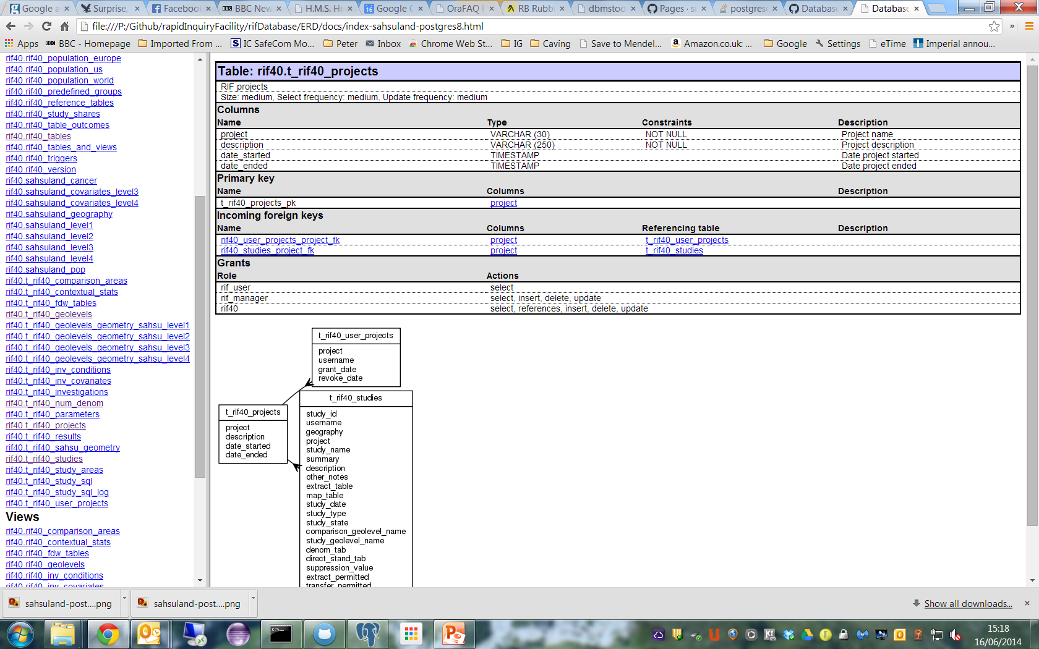
V4.0 RIF Design Documentation

Slide 17
V4.0 RIF Database Design
Information about the design can also be accessed using tools:
Psql (Postgres command line) \d<letter>; e.g. \dS+ to describe a relation with comments. Will display view text for a view.
pgAdmin III. Graphical GUI. Can view SQL to gernate objects and execute SQL statements, including graphical execution plans.

Slide 18
Accessing Postgres
Two database sahsuland (loaded from a logical database dump), and sahsuland_dev (built from scripts).
Unless you are working on the database structure itself use the sahsuland database, connect as yourself using:
psql –d sahsuland
In Java you will need to run the rif40_startup() function to setup the database correctly. Postgres does not have an ON-LOGON trigger.

Slide 19
Psql
P:\Github\rapidInquiryFacility\rifDatabase\ERD\docs>psql -d sahsuland
You are connected to database "sahsuland" as user "pch" on host "wpea-rif1" at port "5432".
SSL connection (cipher: DHE-RSA-AES256-SHA, bits: 256)
psql:C:/Program Files/PostgreSQL/9.3/etc/psqlrc:36: INFO: rif40_log_setup() send DEBUG to INFO: off; debug function list: []
psql:C:/Program Files/PostgreSQL/9.3/etc/psqlrc:36: INFO: rif40_startup(): SQL> SET search_path TO pch,rif40, public, topology, gis, pop, rif40_sql_pkg,rif_studies;
psql:C:/Program Files/PostgreSQL/9.3/etc/psqlrc:36: INFO: rif40_startup(): PostGIS extension V2.1.1 (POSTGIS="2.1.1 r12113" GEOS="3.4.2-CAPI-1.8.2 r3924" PROJ="Rel. 4.8.0, 6 March 2012" GDAL="GDAL 1.10.0, released 2013/04/24" LIBXML="2.7.8" LIBJSON="UNKNOWN" TOPOLOGY RASTER)
psql:C:/Program Files/PostgreSQL/9.3/etc/psqlrc:36: INFO: rif40_startup(): FDW functionality disabled - FDWServerName, FDWServerType, FDWDBServer RIF parameters not set.
psql:C:/Program Files/PostgreSQL/9.3/etc/psqlrc:36: INFO: rif40_startup(): V$Revision: 1.11 $ DB version $Revision: 1.11 $ matches
psql:C:/Program Files/PostgreSQL/9.3/etc/psqlrc:36: INFO: rif40_startup(): V$Revision: 1.11 $ rif40_geographies, rif40_tables, rif40_health_study_themes exist for user: pch
psql:C:/Program Files/PostgreSQL/9.3/etc/psqlrc:36: INFO: rif40_startup(): search_path: rif40, public, topology, gis, pop, rif40_sql_pkg, rif_studies, reset: rif40, public, topology, gis, pop, rif40_sql_pkg
psql:C:/Program Files/PostgreSQL/9.3/etc/psqlrc:36: INFO: rif40_startup(): Created temporary table: g_rif40_study_areas
psql:C:/Program Files/PostgreSQL/9.3/etc/psqlrc:36: INFO: rif40_startup(): Created temporary table: g_rif40_comparison_areas
psql:C:/Program Files/PostgreSQL/9.3/etc/psqlrc:36: INFO: rif40_startup(): Deleted 0, created 2 tables/views/foreign data wrapper tables
DO
psql (9.3.2)
SSL connection (cipher: DHE-RSA-AES256-SHA, bits: 256)
Type "help" for help.
sahsuland=>

Slide 20
Postgres – \dS, \dS+ commands
sahsuland_dev=> \dS t_rif40_studies
Table "rif40.t_rif40_studies"
Column | Type | Modifiers
--------------------------+-----------------------------+-----------------------------------------------------------------------------------
study_id | integer | not null default (nextval('rif40_study_id_seq'::regclass))::integer
username | character varying(90) | default "current_user"()
geography | character varying(30) | not null
project | character varying(30) | not null
study_name | character varying(200) | not null
summary | character varying(200) |
description | character varying(2000) |
other_notes | character varying(2000) |
extract_table | character varying(30) | not null
map_table | character varying(30) | not null
study_date | timestamp without time zone | default ('now'::text)::timestamp without time zone
study_type | smallint | not null
study_state | character varying(1) | default 'C'::character varying
comparison_geolevel_name | character varying(30) | not null
study_geolevel_name | character varying(30) | not null
denom_tab | character varying(30) | not null
direct_stand_tab | character varying(30) |
suppression_value | smallint | not null
extract_permitted | smallint | default 0
transfer_permitted | smallint | default 0
authorised_by | character varying(90) |
authorised_on | timestamp without time zone |
authorised_notes | character varying(200) |
audsid | character varying(90) | default sys_context('USERENV'::character varying, 'SESSIONID'::character varying)

Slide 21
Postgres – \dS, \dS+ commands - 2
Indexes:
"t_rif40_studies_pk" PRIMARY KEY, btree (study_id)
"t_rif40_extract_table_uk" UNIQUE, btree (extract_table)
"t_rif40_map_table_uk" UNIQUE, btree (map_table)
Check constraints:
"t_rif40_stud_extract_perm_ck" CHECK (extract_permitted = ANY (ARRAY[0, 1]))
"t_rif40_stud_transfer_perm_ck" CHECK (transfer_permitted = ANY (ARRAY[0, 1]))
"t_rif40_studies_study_state_ck" CHECK (study_state::text = ANY (ARRAY['C'::character varying, 'V'::character varying, 'E'::character varying, 'R'::character varying, 'U'::char
acter varying]::text[]))
"t_rif40_studies_study_type_ck" CHECK (study_type = ANY (ARRAY[1, 11, 12, 13, 14, 15]))
Foreign-key constraints:
"rif40_studies_project_fk" FOREIGN KEY (project) REFERENCES t_rif40_projects(project)
"t_rif40_std_comp_geolevel_fk" FOREIGN KEY (geography, comparison_geolevel_name) REFERENCES t_rif40_geolevels(geography, geolevel_name)
"t_rif40_std_study_geolevel_fk" FOREIGN KEY (geography, study_geolevel_name) REFERENCES t_rif40_geolevels(geography, geolevel_name)
"t_rif40_stud_denom_tab_fk" FOREIGN KEY (denom_tab) REFERENCES rif40_tables(table_name)
"t_rif40_stud_direct_stand_fk" FOREIGN KEY (direct_stand_tab) REFERENCES rif40_tables(table_name)
"t_rif40_studies_geography_fk" FOREIGN KEY (geography) REFERENCES rif40_geographies(geography)
Referenced by:
TABLE "rif40_study_shares" CONSTRAINT "rif40_study_shares_study_id_fk" FOREIGN KEY (study_id) REFERENCES t_rif40_studies(study_id)
TABLE "t_rif40_comparison_areas" CONSTRAINT "t_rif40_compareas_study_id_fk" FOREIGN KEY (study_id) REFERENCES t_rif40_studies(study_id)
TABLE "t_rif40_investigations" CONSTRAINT "t_rif40_inv_study_id_fk" FOREIGN KEY (study_id) REFERENCES t_rif40_studies(study_id)
TABLE "t_rif40_study_sql_log" CONSTRAINT "t_rif40_study_sqllog_stdid_fk" FOREIGN KEY (study_id) REFERENCES t_rif40_studies(study_id)
TABLE "t_rif40_study_areas" CONSTRAINT "t_rif40_studyareas_study_id_fk" FOREIGN KEY (study_id) REFERENCES t_rif40_studies(study_id)
Triggers:
t_rif40_studies_checks BEFORE INSERT OR DELETE OR UPDATE ON t_rif40_studies FOR EACH ROW EXECUTE PROCEDURE rif40_trg_pkg.trigger_fct_t_rif40_studies_checks()

Slide 22
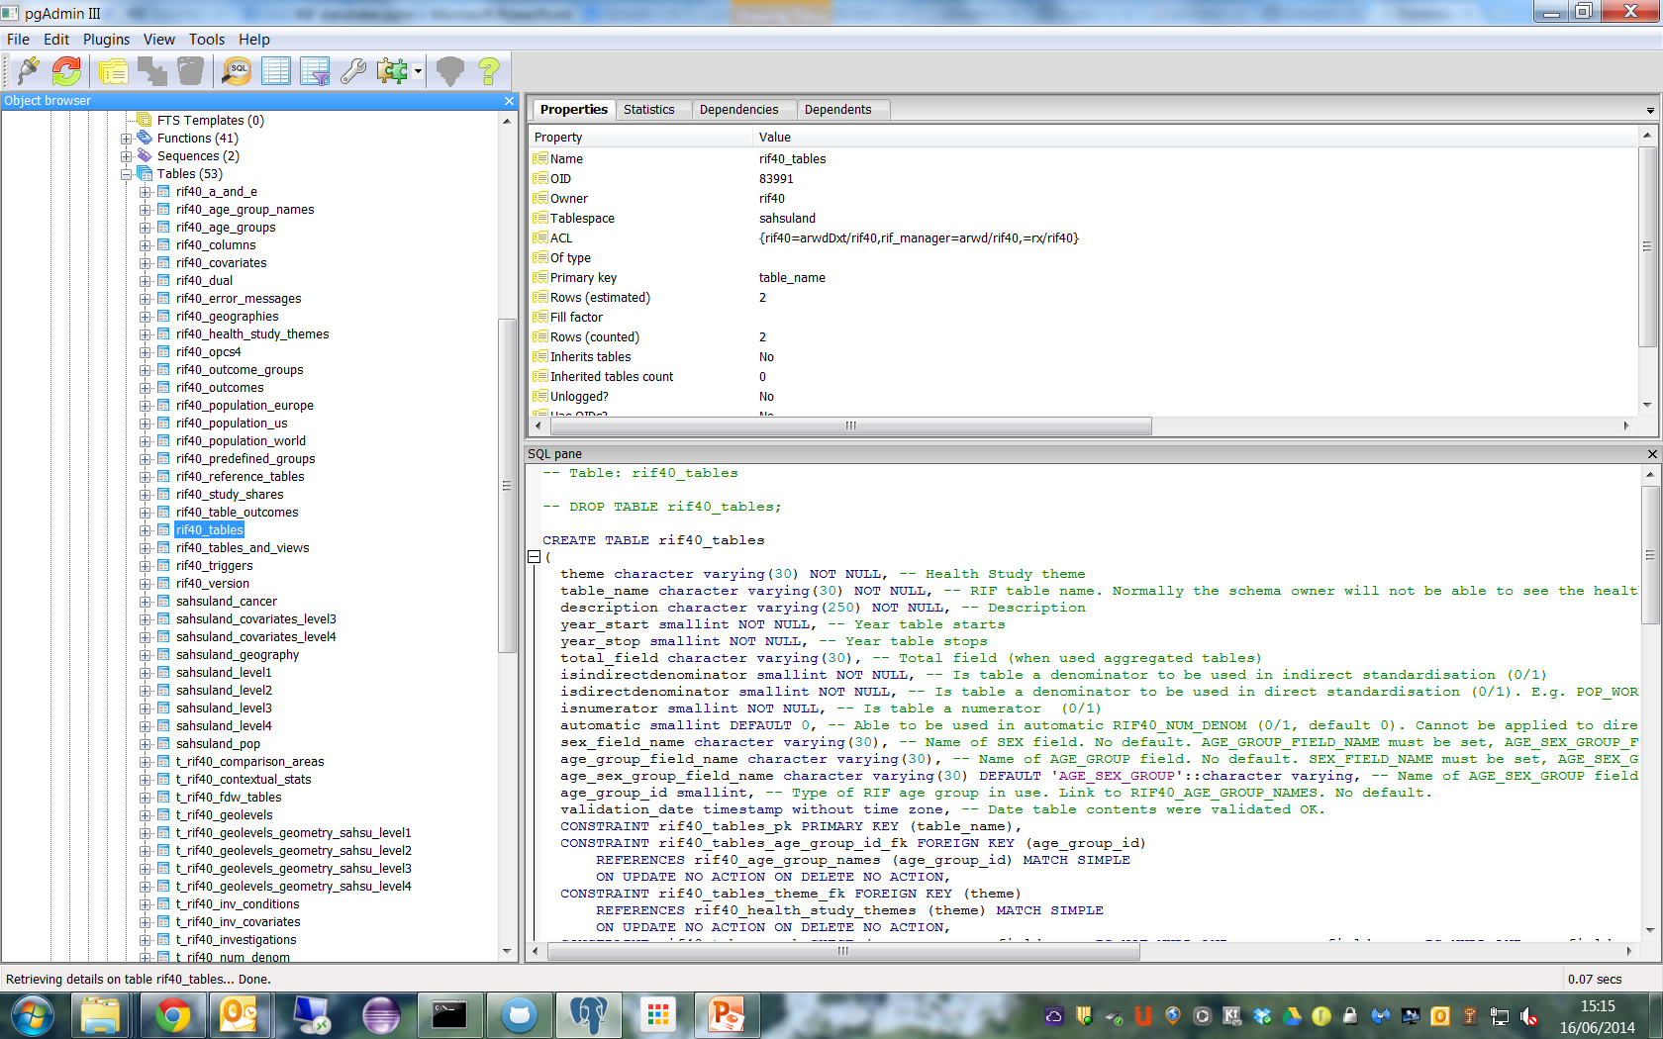
Postgres pgAdmin III

Slide 23
1. V4.0 RIF Table types
Continued

Slide 24
V4.0 RIF Working Tables
These always contain a study_id column!
E.g. T_RIF40_STUDIES.
RIF40_STUDIES is a view with the same fields that only displays the study rows you can access.
The RIF40_STUDIES view must be used for SELECT, INSERT, UPDATE and DELETE.
T_RIF40_STUDIES is not accessible by normal users.

Slide 25
V4.0 RIF Data Tables
Defined in RIf40_TABLES, RIF40_COVARIATES, RIF40_OUTCOMES; E.g.
Health (SAHSULAND_CANCER)
Population (SAHSULAND_POP)
Covariate data (sahsuland_covariates_level3/4)
Standard populations (RIF40_POPULATION_WORLD)
ICD9/10. These are still present, but with cancer codes only. They will shortly be placed in a noSQL database so we obey the WHO’s copyright.

Slide 26
V4.0 RIF Study Tables
Defined by the RIF40_STUDIES MAP_TABLE (results data) and EXTRACT_TABLE (combined numerator and denominator data) columns.
In Postgres they are found in the RIF_STUDIES schema.
Owned by RIF40, not the user creating them!

Slide 27
V4.0 RIF Meta data tables
Every other table in the RIF is a meta data table…

Slide 28
ICD Codes
To protect WHO copyright must not be accessible to end users.
Will use a noSQL database (e.g. not mongoDB; something simple will do fine)

Slide 29
Meet the outcomes tables….
Outcomes table allow the RIF to support more than just ICD9/10 codes
These are liable to redesign at some point!

Slide 30
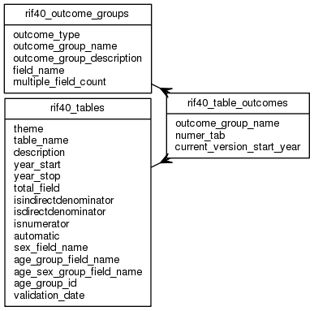
RIF40_TABLE_OUTCOMES
outcome_group_name | numer_tab | current_version_start_year
-------------------+------------------+----------------------------
SINGLE_ICD | SAHSULAND_CANCER | 1993

Slide 31
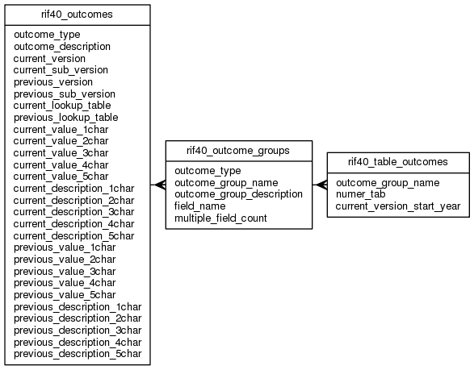
RIF40_OUTCOME_GROUPS
outcome_type | outcome_group_name | outcome_group_description | field_name | multiple_field_count
-------------+-------------------------+---------------------------------------+---------------+---------------------
ICD | SINGLE_ICD | Single ICD | ICD_SAHSU_01 | 0
ICD | MORTALITY_SECONDARY_ICD | Single ICD - Secondary cause of Death | ICD_SAHSU_01S | 0
ICD | MORTALITY_MULTIPLE_ICD | ONS Mortality multiple ICD | ICD_SAHSU | 16
ICD | HES_MULTIPLE_ICD | HES multiple ICD | ICD_SAHSU | 20

Slide 32
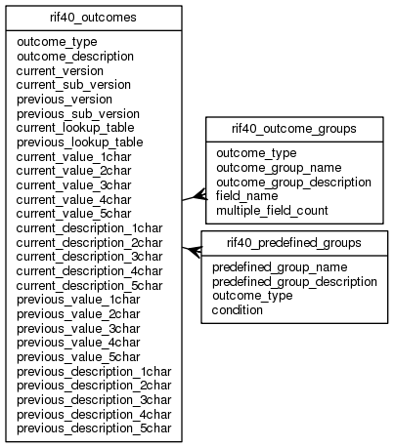
RIF40_OUTCOMES
outcome_type | outcome_description | current_lookup_table | current_value_4char
-------------+------------------------------------------------------+----------------------+---------------------
ICD | International Classification of Disease | RIF40_ICD10 | ICD10_4CHAR
ICD-O | International Classification of Disease for Oncology | RIF40_ICD_O_3 | ICD_O_3_4CHAR
A&E | A&E clinical diagnosis (3 char) | RIF40_A_AND_E |
BIRTHWEIGHT | Birthweight (e.g. low <2500g) | |

Slide 33
3. Differences between the V3.1 RIF and V4.0
Geospatial database.
Fully relational design with validation triggers.
Multi user.
Auditing and information governance support.
Fully partitioned and indexed.

Slide 34
Differences between the V3.1 RIF and V4.0 - 2
Extract (combined numerator and denominator data) and map tables (results data).
No intermediate calculations tables.
No Access support.
Oracle only supported as a remote source of health and population data (foreign data in Postgres parlance).
Full Microsoft SQL server port.

Slide 35
Differences between the V3.1 RIF and V4.0 – 3 (Geospatial support)
New partition geolevel geometry tables (e.g. t_rif40_geolevels_geometry_sahsu_level2) supporting:
Original ESRI shapefile data
Simplified geometry
GeoJSON
TopoJSON
Area ID, name, male and female population

Slide 36
Differences between the V3.1 RIF and V4.0 – 4 (Extract table)
sahsuland=> \dS+ rif_studies.s1_extract
Table "rif_studies.s1_extract"
Column | Type | Modifiers | Storage | Stats target | Description
---------------------+----------------------+-----------+----------+--------------+----------------------------------
year | smallint | not null | plain | | Year
study_or_comparison | character varying(1) | not null | extended | | Study (S) or comparison (C) area
study_id | integer | not null | plain | | Study ID
area_id | character varying | not null | extended | | Area ID
band_id | integer | | plain | | Band ID
sex | smallint | | plain | | Sex
age_group | smallint | | plain | | Age group
ses | character varying | | extended | | SES
inv_1 | bigint | | plain | | Lung cancer
total_pop | double precision | | plain | | Total population
Designed for high performance - partitioned by year, index organised.
A test on Oracle extracted 20 health atlas numerator health outcomes in under 5 minutes!
AGE_GROUP, SEX names are fixed; may be different (e.g. AGE_SEX_GROUP) in source data.
Limited to one covariate at present; more may be supported.

Slide 37
Differences between the V3.1 RIF and V4.0 - 5
RIF40_TABLES:
Removed “unrotated” population table support (e.g. M0, R4_9, M85PLUS).
Add fields to support separate AGE/SEX or AGE_SEX_GROUP columns.
Support for multiple health outcomes.
Remote Oracle support.
Health study themes.

Slide 38
Differences between the V3.1 RIF and V4.0
RIF40_STUDIES:
Extract and map tables.
Information governance support (suppression values, extract permitted, AUDSID etc).
Study shares.
Study SQL log.

Slide 39
Differences between the V3.1 RIF and V4.0
RIF40_INVESTIGATIONS:
Removing foreign key to geography!
Normalise investigation conditions (e.g. ICD code filters) and covariates.

Slide 40
Differences between the V3.1 RIF and V4.0
RIF40_GEOGRAPHY:
Added default study area.
Added geospatial support (SRID, MAX_GEOJSON_DIGITS).
Postal population support

Slide 41
Differences between the V3.1 RIF and V4.0
RIF40_GEOLEVELS:
Added geospatial support:
Shapefile table, area id column, desc(ription) column
Centroids table, area_id column
Various processing stats from simplification, GEO/TopeJSON support, e.g. avg_npoints_geom
Geospatial tables, e.g. t_rif40_sahsu_geometry, t_rif40_geolevels_geometry_sahsu_level1

Slide 42
Differences between the V3.1 RIF and V4.0
RIF40_NUM_DENOM:
Automatic numerator denominator support:
1 denominator/geography
Marked as automatic is RIF40_TABLES
What you see is what you can access!
RIF40_NUM_DENOM_ERRORS is supplied for debug purposes

Slide 43
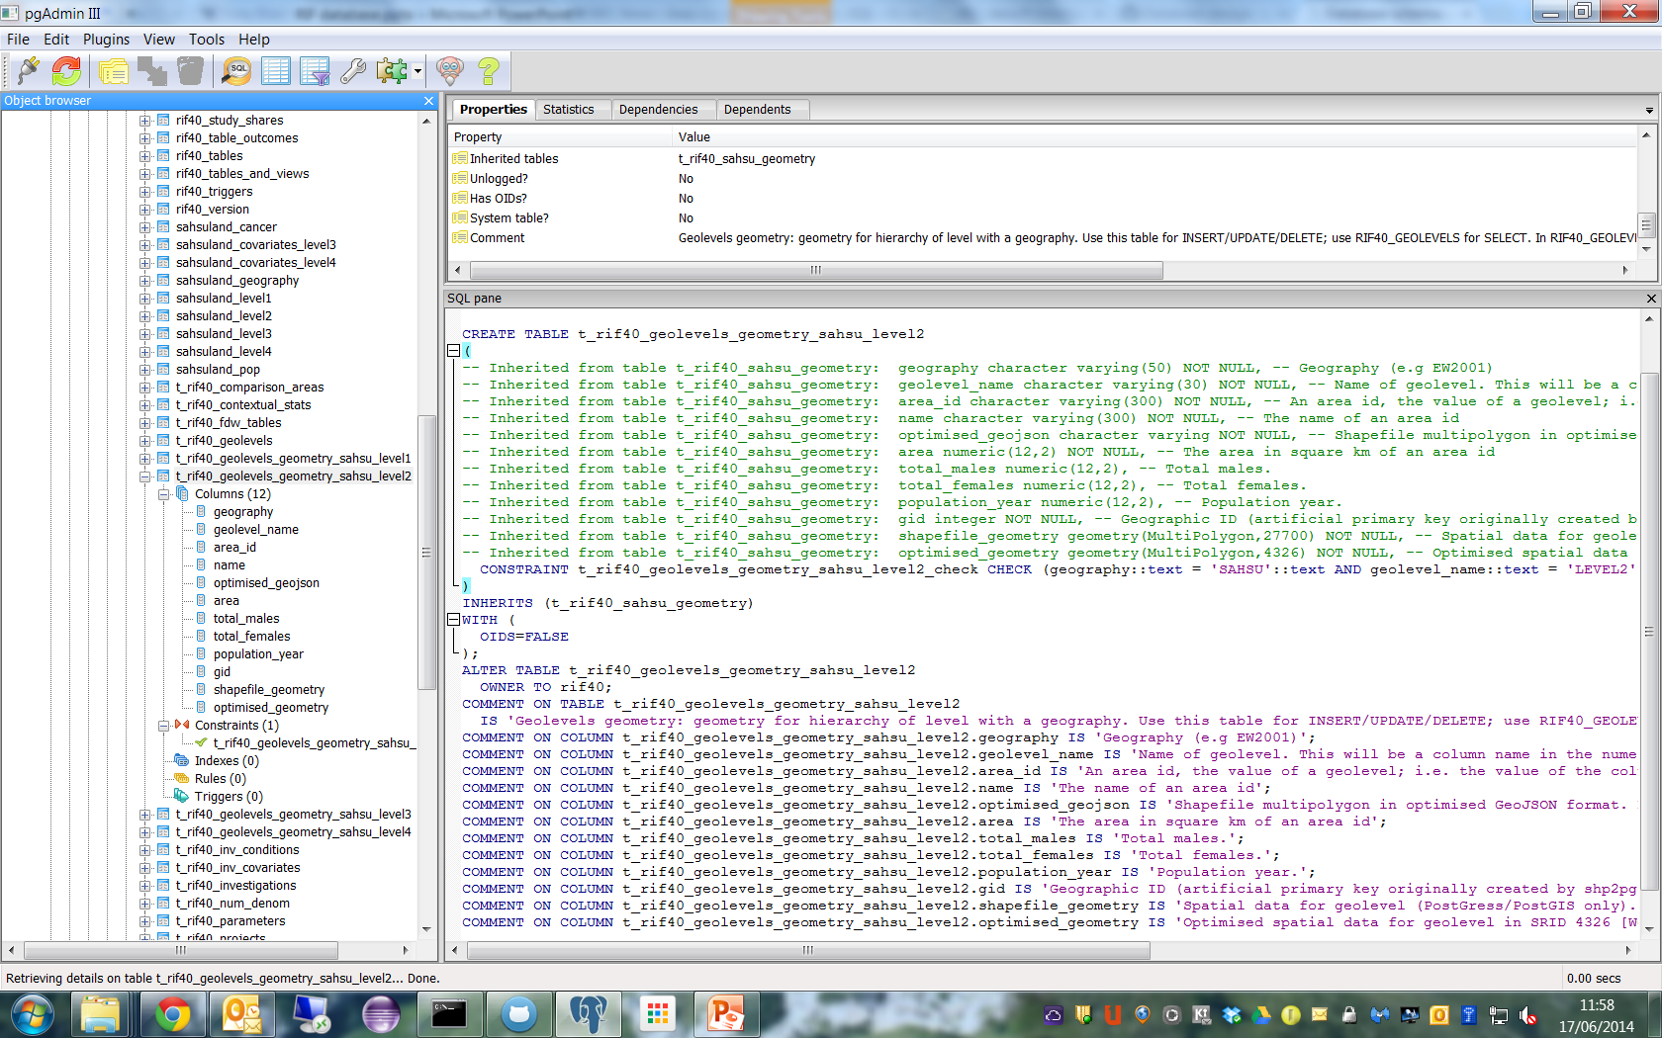
t_rif40_geolevels_geometry_sahsu_level2

Slide 44
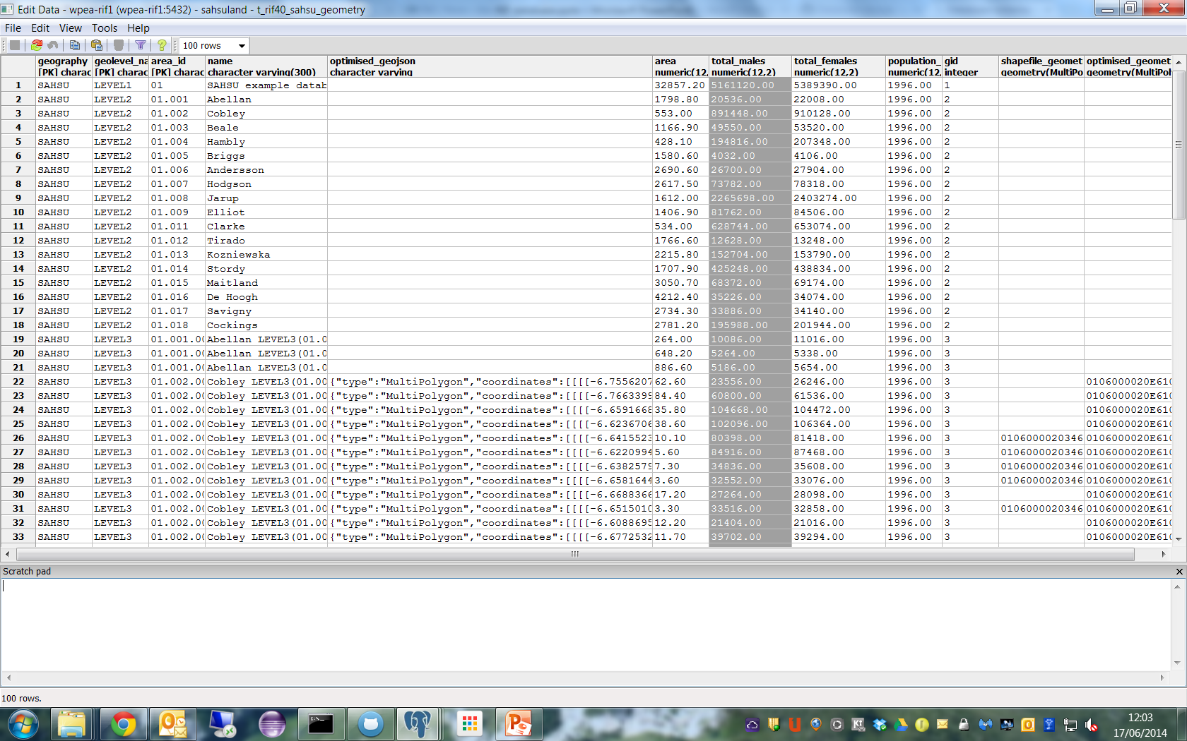
t_rif40_sahsu_geometry

Slide 45
4. Handling porting issues
The database will only contain procedural code to support triggers.
Current code to support geospatial simplification, topoJSON and data extraction will be migrated in stages to the middleware.
All statistics work will be done in the middleware using the Java R Interface (http://rforge.net/JRI/)
Extraction and results calculation will eventually be carried out in batch, for the moment the middleware will call JRI directly.

Slide 46
Handling porting issues - specifics
Beware of CASE sensitivity. Oracle is an uppercase database! SELECT * FROM “sahsuland_cancer” is bad…
Avoid functions unless they are part of the RIF schema or standard to both Postgres and SQL Server.
Avoid cursor control keywords: LIMIT SCROLL, LAST, RELATIVE etc in extraction code (Oracle only supports scrollable cursors in the C interface!)
Use CASE WHEN … not DECODE(), IIFF() etc.
Do use MERGE (Oracle) or common table expression updates (Postgres) as they are much faster.

